Slide 1

CE101 Engineering Drawing Lec7: Section of Solids
Indian Institute of Technology Guwahati
Notes:
Today we will discuss about the Modeling and

Slide 2
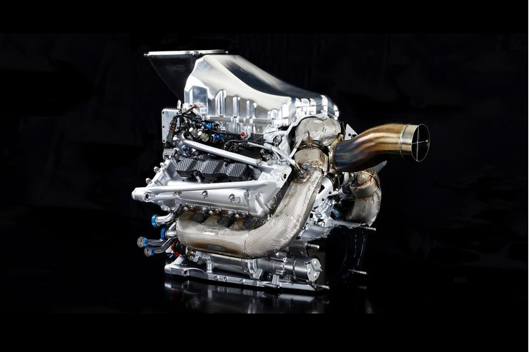

Slide 3
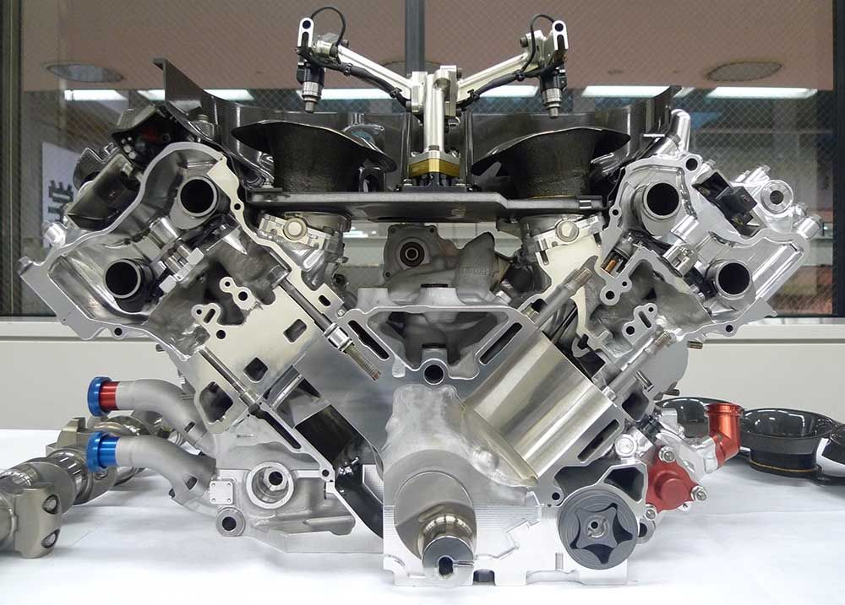

Slide 4
Sections of Solids

Slide 5
Sectional Views
If there are many hidden lines, it is difficult to visualize the shape of the object
unnecessarily complicated and confusing.
Therefore, the general practice is to draw sectional views for complex objects in addition to or instead of simple orthographic views.
A sectional view, as the name suggests, is obtained by taking the section of the object along a particular plane. An imaginary cutting plane is used to obtain the section of the object.

Slide 6
Theory of Sectioning
Whenever a section plane cuts a solid, it intersects (and or coincides with) the edges of the solids.
The point at which the section plane intersects an edge of the solid is called the point of intersection (POI).
POIs are located in one view and then projected in the desired view to draw the section.
In case of the solids having a curved surface, viz., cylinder, cone and sphere, POIs are located between the cutting plane and the lateral lines.

Slide 7
Types of Cutting Planes and Their Representation
A cutting plane is represented by a cutting plane line
The cutting plane line indicates the line view of the cutting plane.
The two ends of the cutting plane line are made slightly thicker and
provided with arrows.
The direction of the arrow indicates the direction of viewing of the object.
OBSERVER
ASSUME
UPPER PART
REMOVED
SECTON PLANE
IN FV.

Slide 8
SECTIONING A SOLID.
An object ( here a solid ) is cut by
some imaginary cutting plane
to understand internal details of that object.
The action of cutting is called
SECTIONING a solid
&
The plane of cutting is called
SECTION PLANE.
Two cutting actions means section planes are recommended.
A) Section Plane perpendicular to Vp and inclined to Hp.
( This is a definition of an Aux. Inclined Plane i.e. A.I.P.)
NOTE:- This section plane appears
as a straight line in FV.
B) Section Plane perpendicular to Hp and inclined to Vp.
( This is a definition of an Aux. Vertical Plane i.e. A.V.P.)
NOTE:- This section plane appears
as a straight line in TV.
Remember:-
1. After launching a section plane
either in FV or TV, the part towards observer
is assumed to be removed.
2. As far as possible the smaller part is
assumed to be removed.
OBSERVER
ASSUME
UPPER PART
REMOVED
SECTON PLANE
IN FV.
(A)
(B)
ASSUME
LOWER PART
REMOVED
SECTON PLANE
IN TV.
OBSERVER

Slide 9
ILLUSTRATION SHOWING
IMPORTANT TERMS
IN SECTIONING.
For TV
For True Shape
SECTION
PLANE
TRUE SHAPE
Of SECTION
x
y
Apparent Shape
of section
SECTION LINES
(45⁰ to XY)
SECTIONAL T.V.

Slide 10
True Shape of Sections
A section will show its true shape when viewed in normal direction.
To find the true shape of a section, it must be projected on a plane parallel to the section plane.
True shape of section
Horizontal section plane -> TV
Vertical section plane -> FV
Profile section plane -> SV
AIP -> Auxiliary TV
AVP -> Auxiliary FV

Slide 11


Typical Section Planes
&
Typical Shapes
Of
Sections.
Triangle
Section Plane
Through Generators
Ellipse
Section Plane
Through Apex
Parabola
Section Plane Parallel
to end generator.
Section Plane
Parallel to Axis.
Hyperbola
Ellipse
Trapezium
Cylinder through
generators.
Sq. Pyramid through
all slant edges

Slide 12
Theory of Sectioning – Contd.
Flat section will never cut all the edges of polyhedron, but cuts only few of them
A section plane will cut a minimum of three edges of the polyhedral – Creating 3 POIs
Maximum number of POIs
Type of Solid | Maximum POIs
Prism and Cube | (Number of sides of base) + 2
Pyramid (and Tetrahedron) | (Number of sides of base) + 1

Slide 13
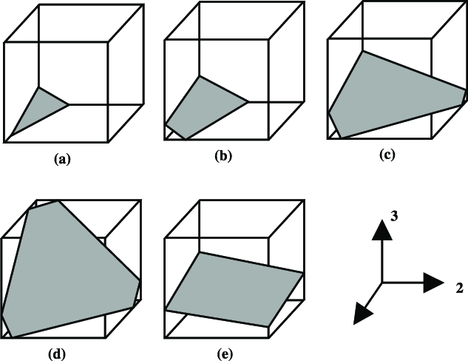

Slide 14
Theory of Sectioning – Contd.
True shape
Polyhedra – Polygon and sides equal to POIs
Solid | Position of the Cutting Plane | True Shape of Section
Cylinder | Perpendicular to axis Inclined to the axis cutting all generators Parallel to the axis | Circle Ellipse Rectangle
Cone | Perpendicular to axis Inclined to the axis cutting all generators Parallel to a generator Inclined to and on one side of the axis Parallel to the axis Passing through the axis or the apex | Circle Ellipse Parabola Hyperbola Rectangular Hyperbola Triangle
Sphere |  | Circle
Pyramids and Prisms |  | Straight line segmented curves

Slide 15
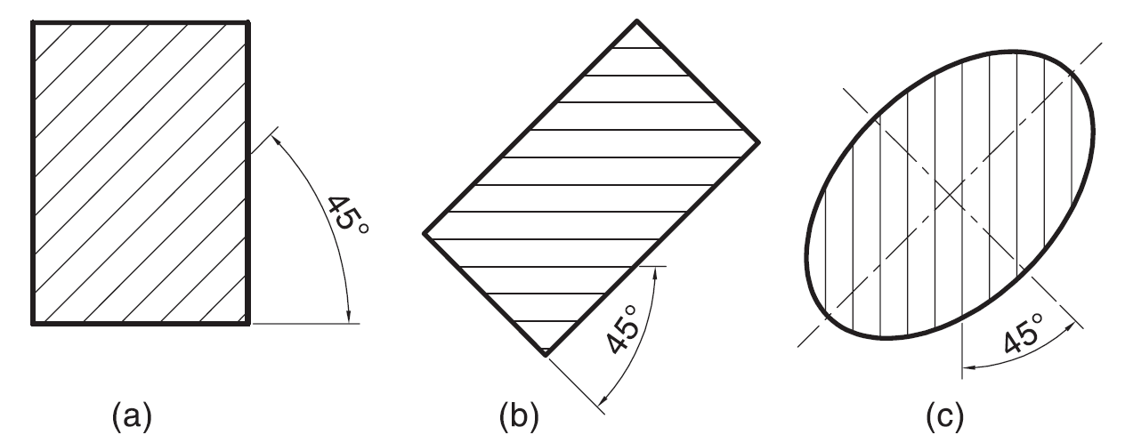
Hatching of the Sections
The surface created by cutting the object by a section plane is called as section. The section is indicated by drawing the hatching lines (section lines) within the sectioned area. The hatching lines are drawn at 45° to the principal outlines or the lines of symmetry of the section. The spacing between hatching lines should be uniform and in proportion to the size of the section.
2H
HB

Slide 16
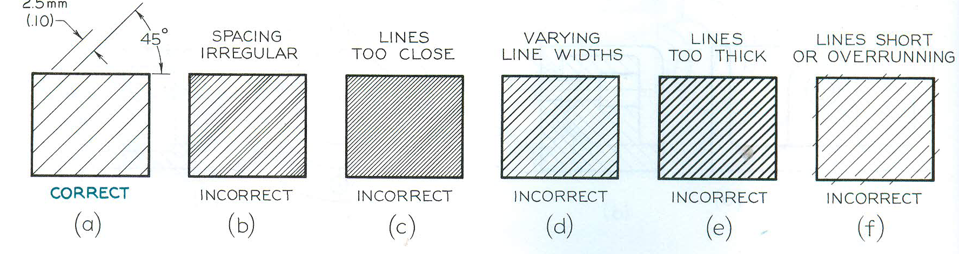
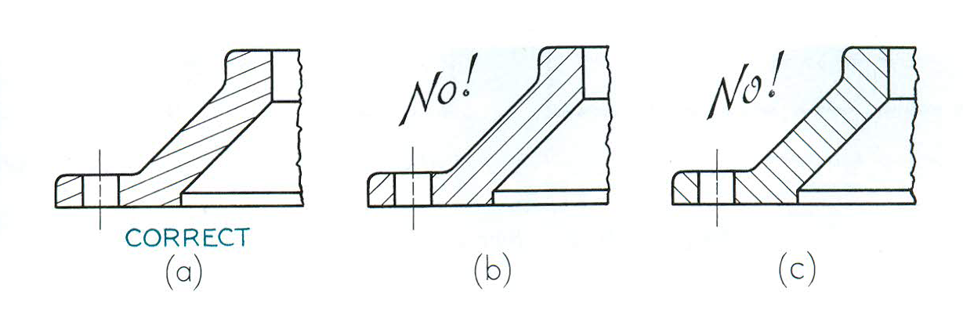
Section Lining Techniques
Section lines should be uniform thin, never varying in thickness
If sections lines drawn at 45° with horizontal are parallel or perpendicular to a prominent visible outline, the angle should be changed to 30° /60°

Slide 17
Types of section Planes:
Perpendicular to H.P. and parallel to V.P.
Perpendicular to V.P. and parallel to H.P.
Perpendicular to V.P. and inclined to H.P.
Perpendicular to H.P. and inclined to V.P.
Perpendicular to both H.P. and V.P.

Slide 18
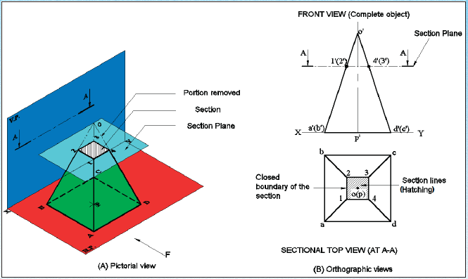

Slide 19
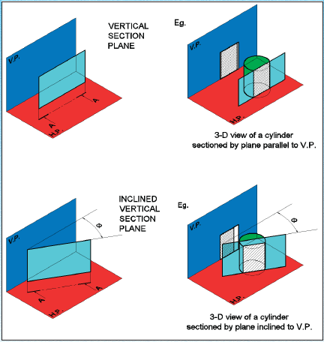

Slide 20
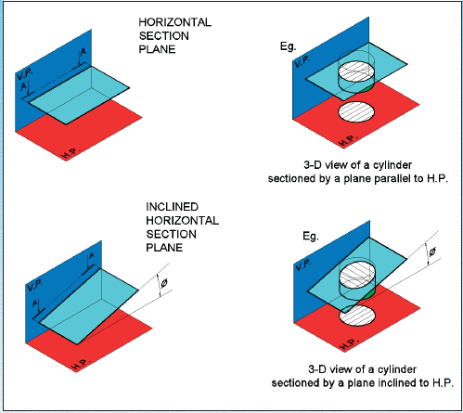

Slide 21
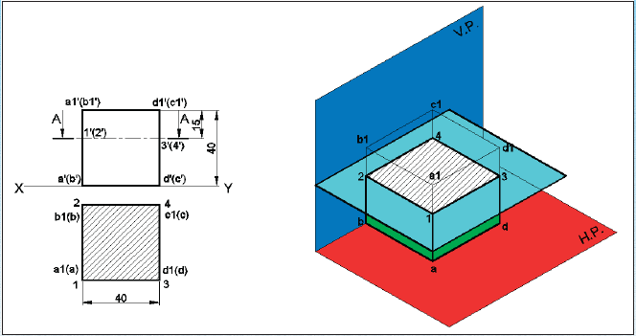
SECTIONAL VIEW – PARALLEL TO H.P AND PERPENDICULAR TO V.P
A cube of 40 mm sideis cut by a horizontal section plane, parallel to H.P at a distance of 15 mm from the top end. Draw the sectional top view and front view

Slide 22
Perpendicular to H.P. and parallel to V.P.
1. A rectangular prism, side of base 40 mm x 25 mm and height 60 mm, rest with its base on H.P. such that one of its larger rectangular faces is parallel to V.P. A section plane perpendicular to H.P. and parallel to V.P. cuts the prism into two equal halves. Draw its top view and sectional front view.
2. A hexagonal prism, side of base 30 mm and axis 60 mm, rest with its base on H.P. such that one of its rectangular faces is parallel to V.P. A section plane perpendicular to H.P. and parallel to V.P. cuts the prism a distance of 10 mm from its axis. Draw its top view and sectional front view.
First try it and solution is given in the next slide.

Slide 23
K. Venugopal : Engineering Drawing and Graphics

Slide 24
Perpendicular to V.P. and parallel to H.P.
A pentagonal pyramid, side of base 30 mm and axis 60 mm, rest with its base on H.P. and one of the edges of its base is perpendicular to V.P. It is cut by section plane perpendicular to V.P. and parallel to H.P. and passing through the axis at a point 35 mm above the base. Draw its top view and sectional front view.
A cone of base 50 mm diameter and axis 65 mm long, lies on H.P. on one of its generators with its axis parallel to V.P. A horizontal sectional plane bisects the axis of the cone. Draw its top view and sectional front view.
First try it and solution is given in the next slide.

Slide 26
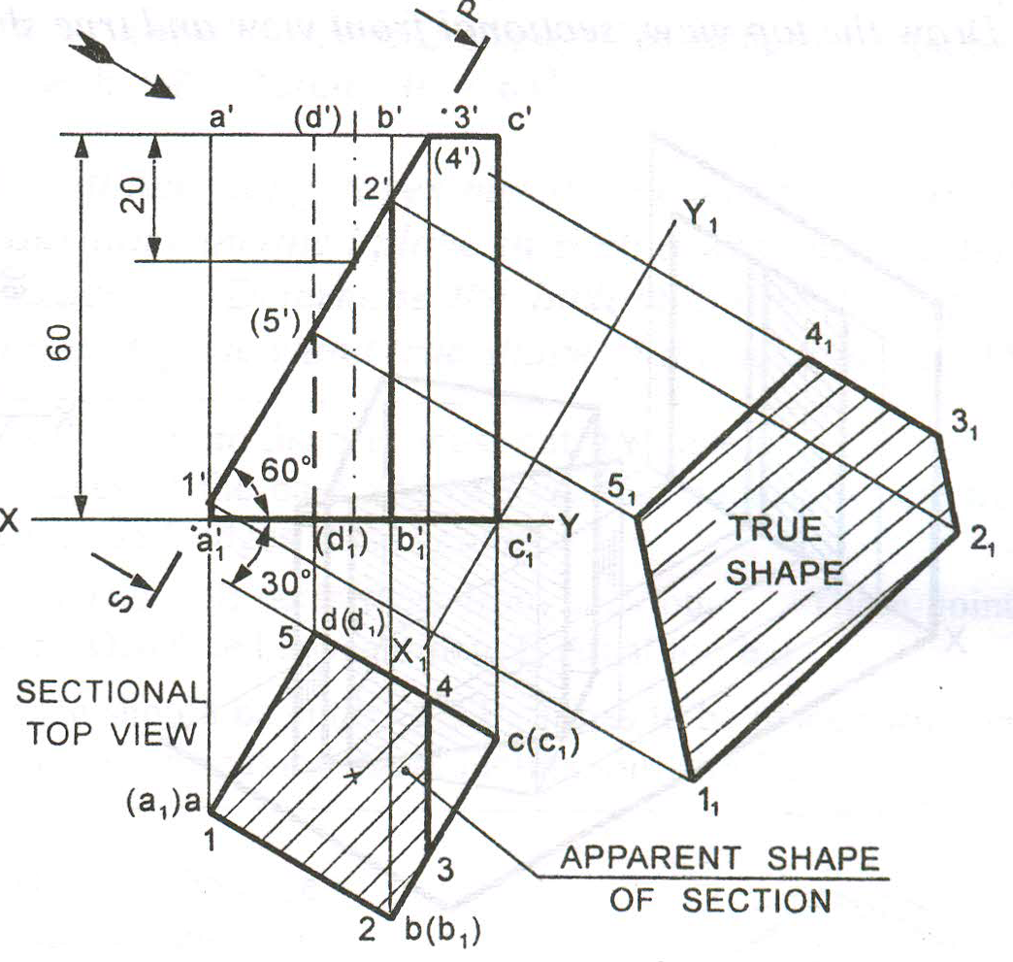
Perpendicular to V.P. and inclined to H.P.
A Square prism, side of base 30 mm and axis 60 mm long, rests with its base on H.P. and one of its rectangular faces is inclined at 30º to VP. A section
Plane perpendicular to V.P. and inclined at 60º to H.P. cuts the axis of the prism at a point 20 mm from its top end. Draw the sectional top view and true shape of the section
a’
d’
b’
c’
20
d(s)
5
1
c(r)
a(p)
4
2
3
b(q)

Slide 27
A square pyramid, base 40 mm side and axis 65 mm long, has its base on the HP and all the edges of the base equally inclined to the VP. It is cut by a section plane, perpendicular to the VP, inclined at 45º to the HP and bisecting the axis. Draw its sectional top view, sectional side view and true shape of the section.
2₁
3₁
X₁
o”
o’
4₁
3”
3’
1₁
4”
2”
2’
4’
1’
X
b’
d’
1”
Y
a’
45º
c’
c”
d
d”
a”
b”
4
a
1
o
c
3
2
b
Y₁

Slide 28
A Hexagonal prism has a face on the H.P. and the axis parallel to the V.P. It is cut by a vertical section plane the H.T. of which makes an angle of 45 with XY and which cuts the axis at a point 20 mm from one of its ends. Draw its sectional front view and the true shape of the section. Side of base 25 mm long height 65mm.
a’
b’
c’
f’
e’
d’
6’
7’
f’
f’
a’
a’
65
1’
5’
b’
b’
e’
e’
2’
c’
Y
X
c’
d’
a’
b’
c’
d’
f’
e’
d’
4’
3’
b
b₁
b₁
1
3
2
a
c
7
a₁
a₁
c₁
c₁
25
Y₁
6
4
f₁
f₁
d₁
f
d
d₁
20
3₁’
2₁’
e
e₁
e₁
1₁’
5
4₁’
7₁’
X₁
5₁’
6₁’

Slide 29
A cone base 75 mm diameter and axis 80 mm long is resting on its base on H.P. It is cut by a section plane perpendicular to the V.P., inclined at 45º to the H.P. and cutting the axis at a point 35 mm from the apex.
Draw the front view, sectional top view, sectional side view and true shape of the section.
X₁
e₁
f₁
g₁
c₁
d₁
h₁
i₁
o’
o”
b₁
j₁
k₁
35
g”
g’
f”
h”
a₁
f’
e’
i”
l₁
h’
e”
i’
d’
d”
j”
c’
j’
k’
c”
k”
b’
b”
l”
a’
l’
a”
X
2 12
3 11
4 10
5 9
6 8
Y
7
10”
1
4”
5”
6”
7”
8”
9”
3”
2”
1”
12”
11”
4
3
5
2
c
d
6
b
e
o
f
1
a
g
7
h
12
l
j
i
8
k
11
9
Y₁
10

Slide 30

Thank You for Patient Hearing

